Slide 1
I. Classification and Vector Spaces
3. Vector Space Models

Slide 2
3. Vector Space Models
Covariance matrices
Dimensionality reduction
Principal Component Analysis
Cosine similarity
Euclidean distance
Co-occurrence matrices
Vector representations
Vector space models

Slide 3
(1) Vector Space Models
Outline
Vector space modes
Advantages
Applications

Slide 4
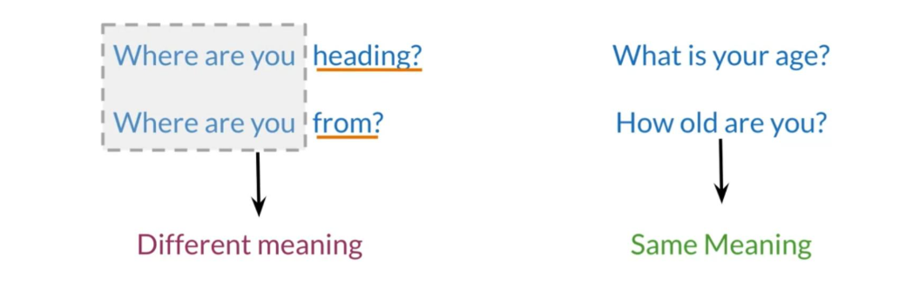
Why learn vector space models?

Slide 5
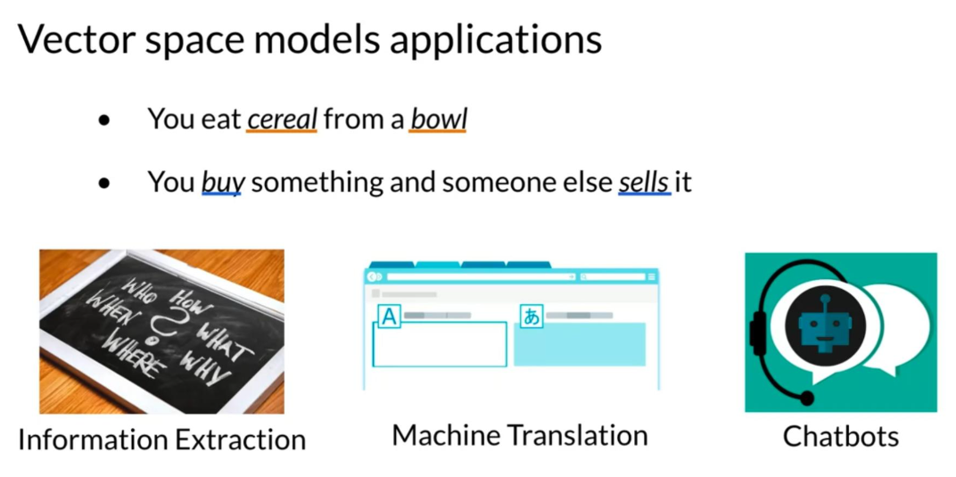
Vector space models applications

Slide 6
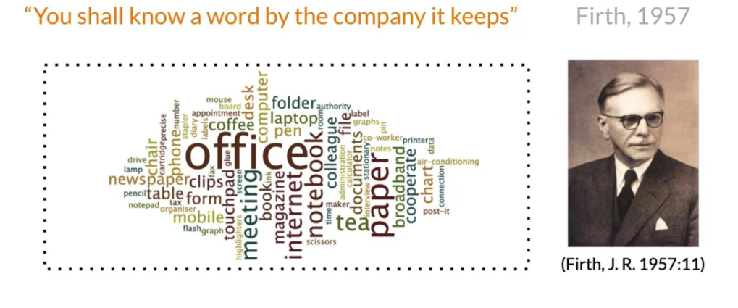
Fundamental concept

Slide 7
Summary
Represent words and documents as vectors
Representation that captures relative meaning

Slide 8
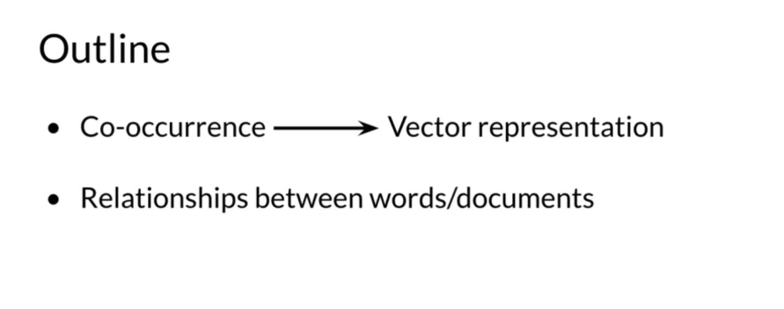
(2) Word by Word and Word by Doc.
Outline
Co-occurrence Vector representation
Relationships between words/documents

Slide 9
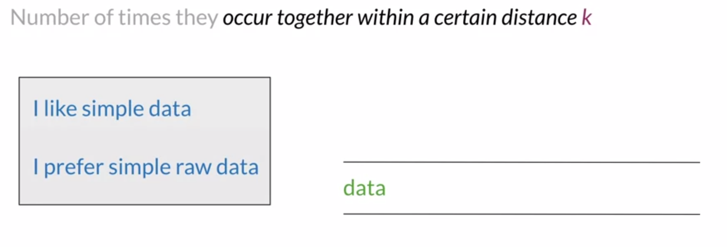
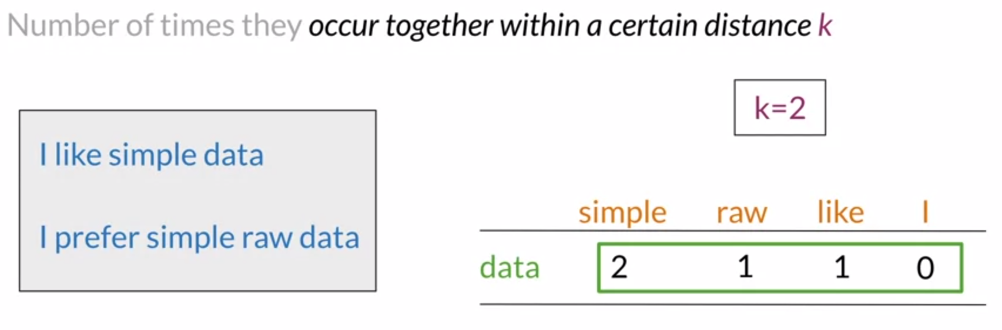
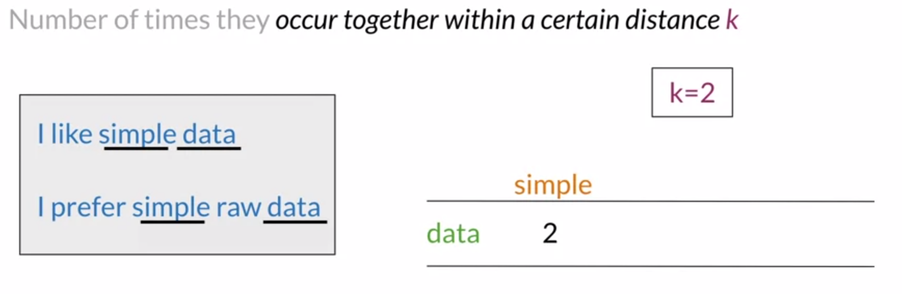
Word by Word Design

Slide 10
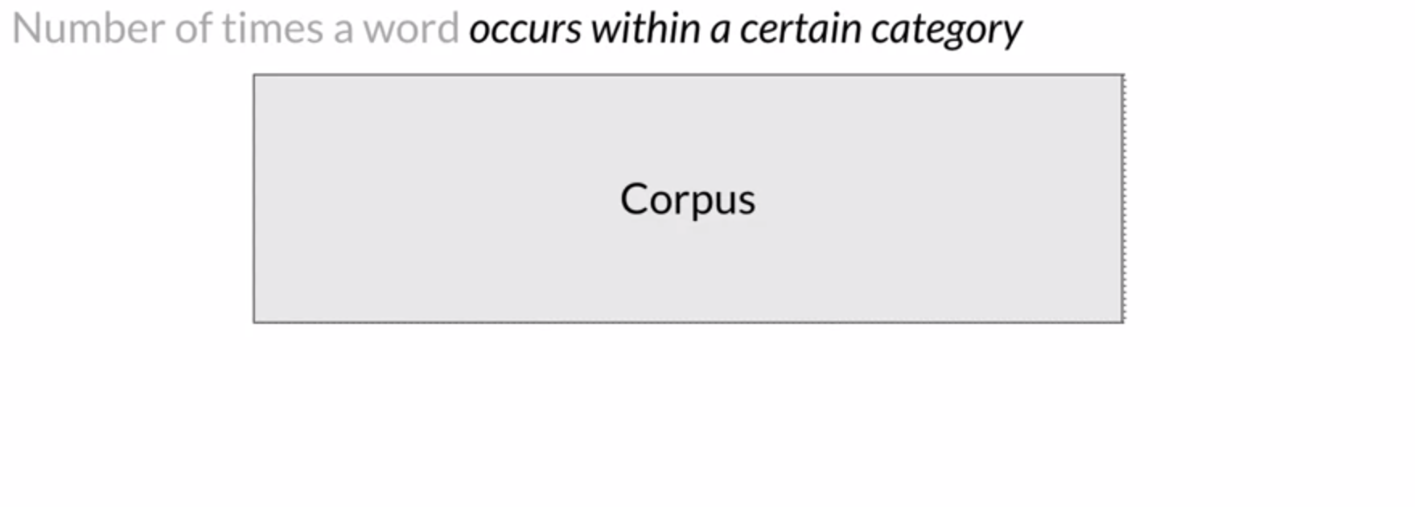
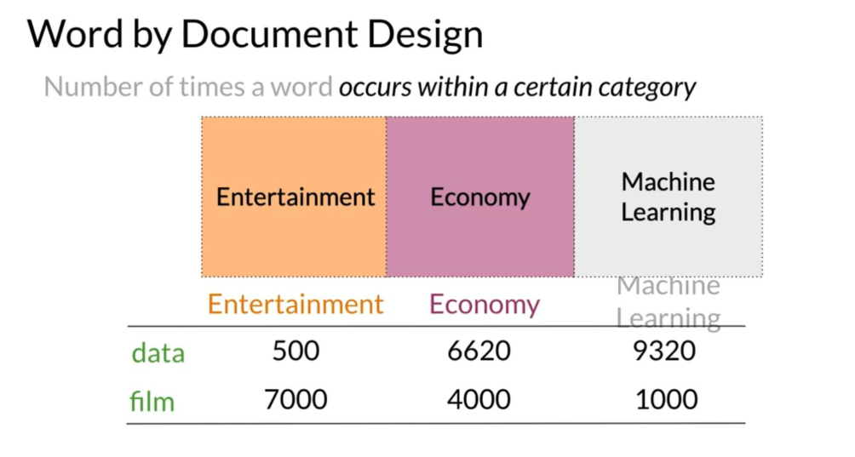
Word by Document Design

Slide 11
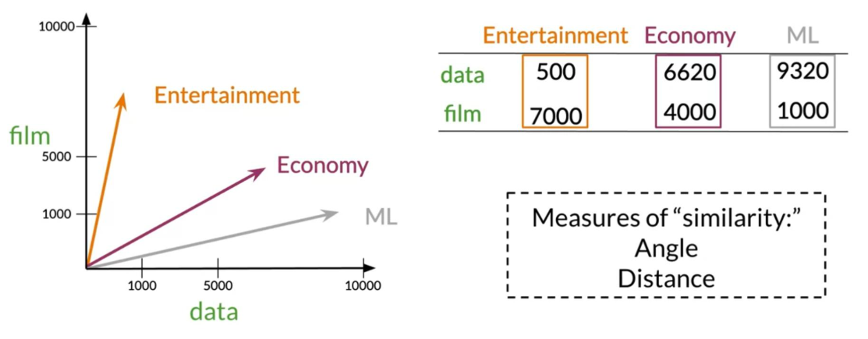
Vector Space

Slide 12
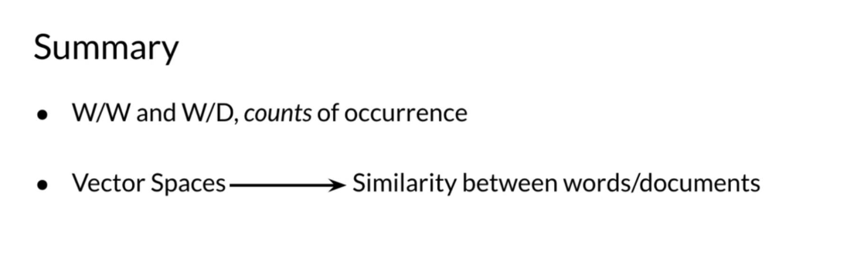
Summary
W/W and W/D, counts of occurrence
Vector Spaces Similarity between words/documents

Slide 13
(3) Euclidean Distance
Outline
Euclidean distance
N-dimension vector representations comparison

Slide 14
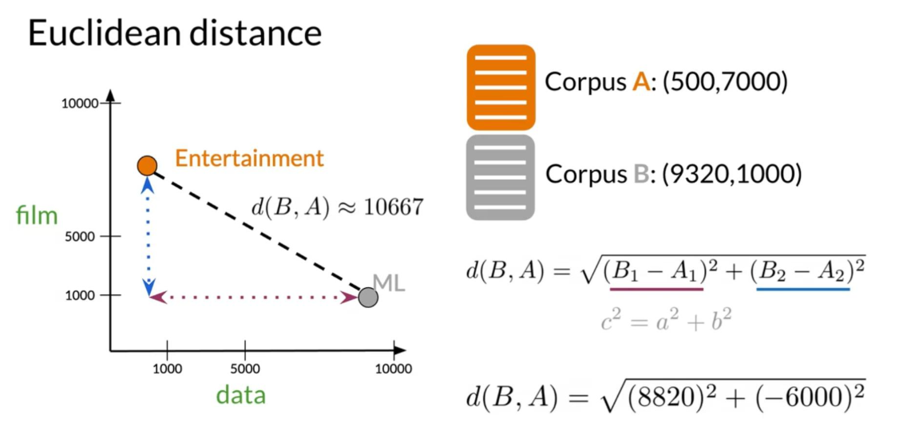
Euclidean distance

Slide 15
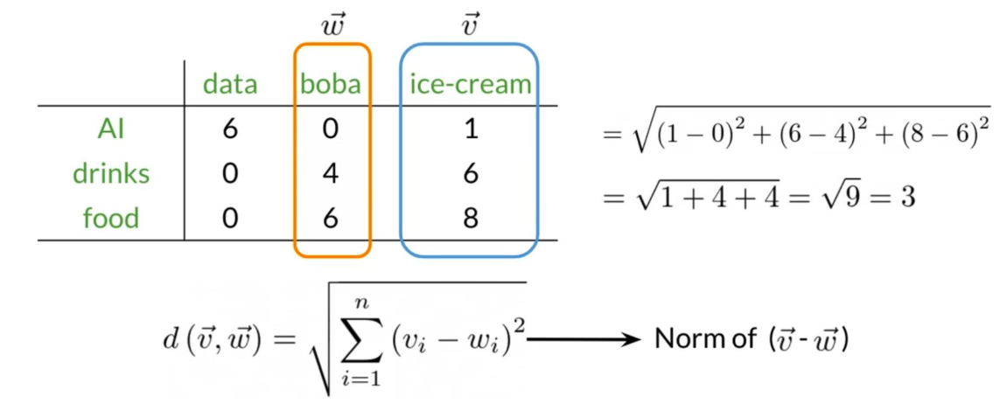
Euclidean distance for n-dimensional vectors

Slide 16
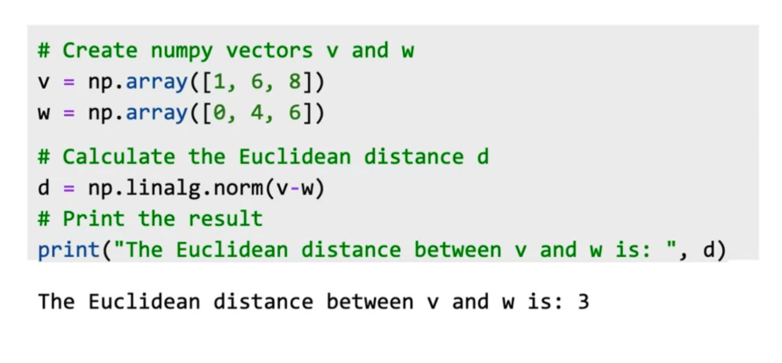
Euclidean distance in Python

Slide 17
Summary
Straight line between points
Norm of the difference between vectors

Slide 18
(4) Cosine Similarity: Intuition
Outline
Problems with Euclidean Distance
Cosine similarity

Slide 19
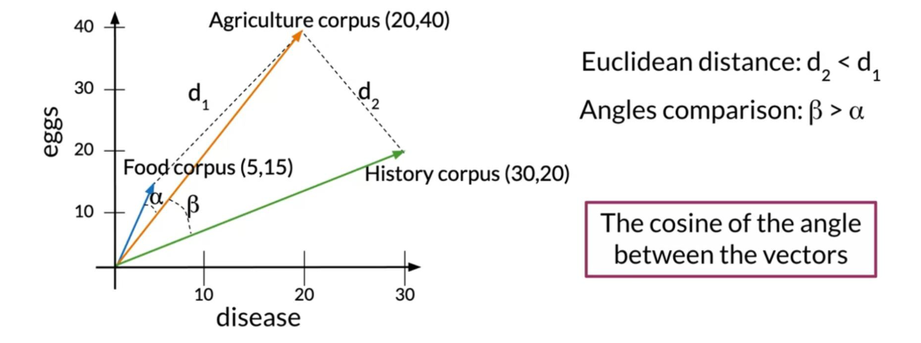
Euclidean distance vs Cosine similarity

Slide 20
Summary
Cosine similarity when corpora are different sizes

Slide 21
(5) Cosine Similarity
Outline
How to get the cosine of the angle between two vectors
Relation of this metric to similarity

Slide 22
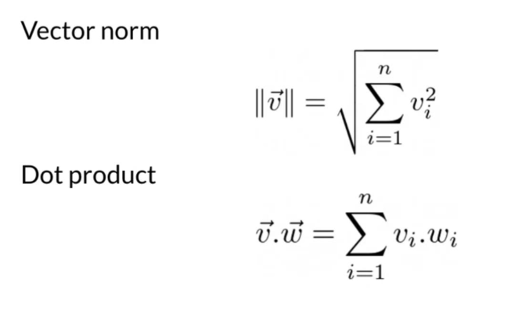
Previous definitions

Slide 23
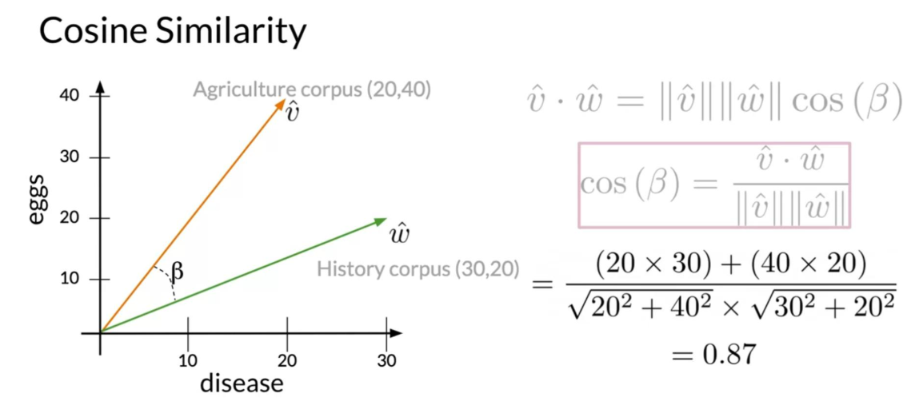
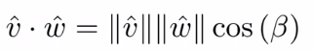
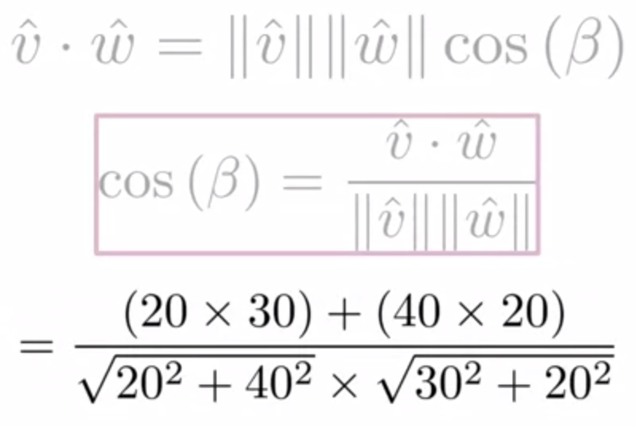
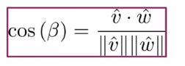
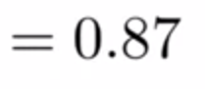
Cosine Similarity

Slide 24
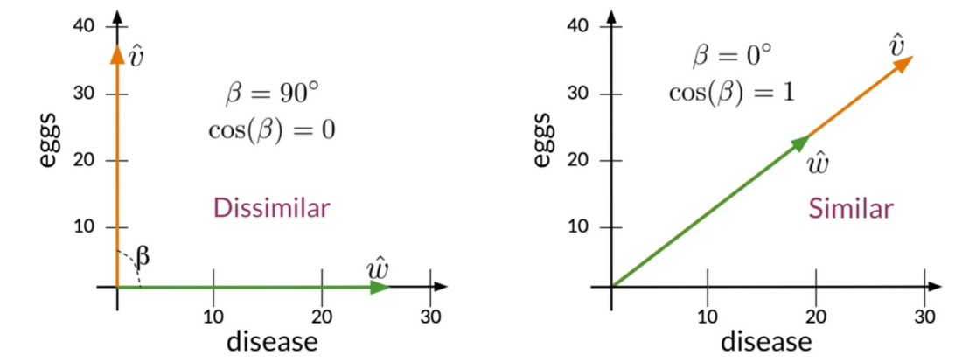
Cosine Similarity

Slide 25
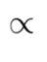
Summary
Cosine Similarity
Cosine Similarity gives values between 0 and 1

Slide 26
(6) Manipulating Words in Vector Spaces
Outline
How to use vector representations

Slide 27
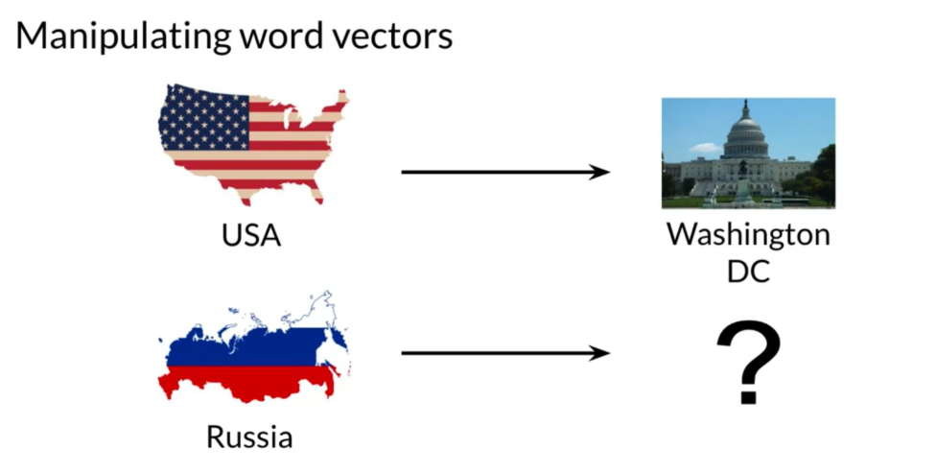
Manipulating word vectors

Slide 28
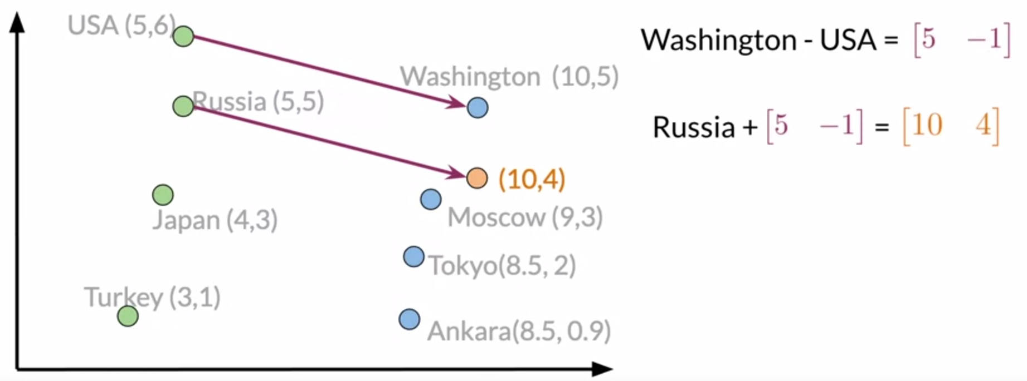
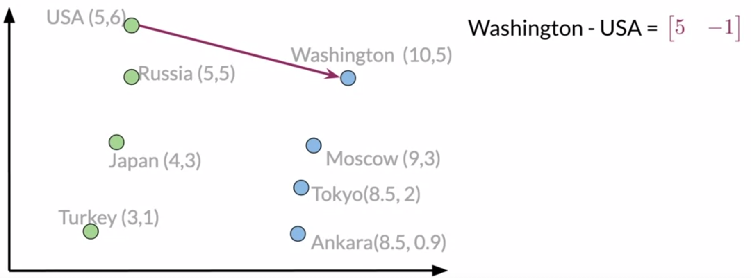
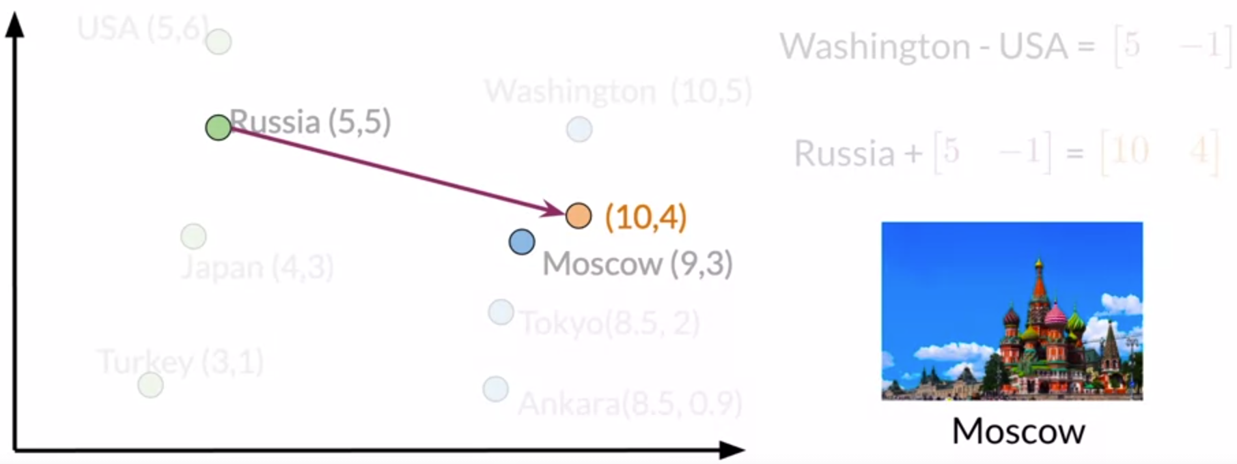
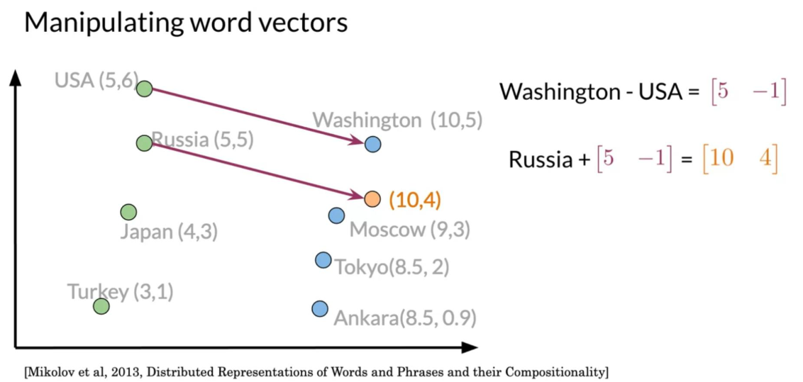
Manipulating word vectors

Slide 29
Summary
Use known relationships to make predictions

Slide 30
(7) Visualization and PCA
Outline
Some motivation for visualization
Principal Component Analysis

Slide 31
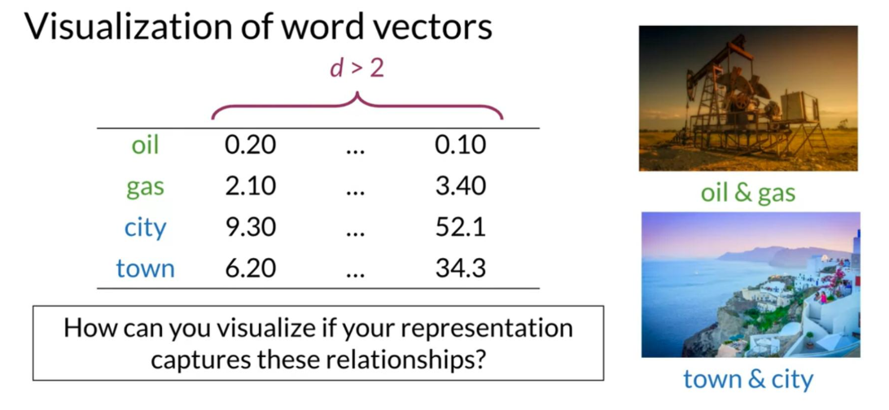
1) Visualization of word vector

Slide 32
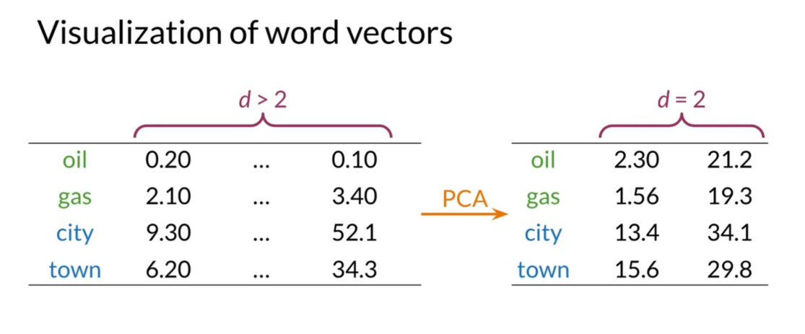
1) Visualization of word vector

Slide 33
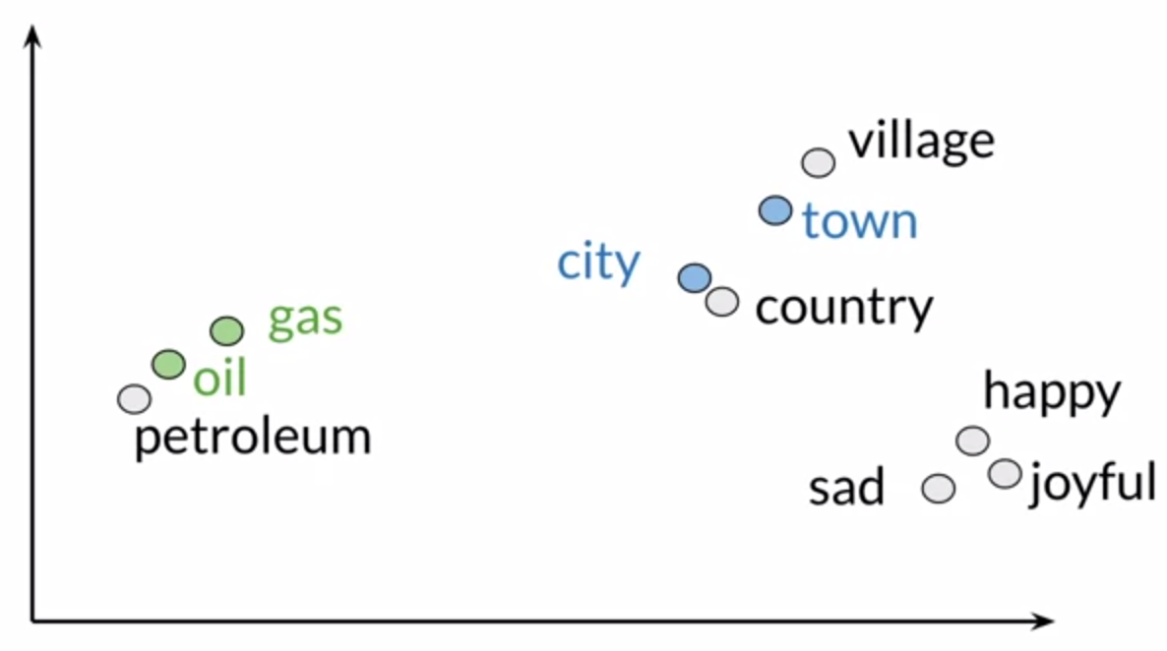
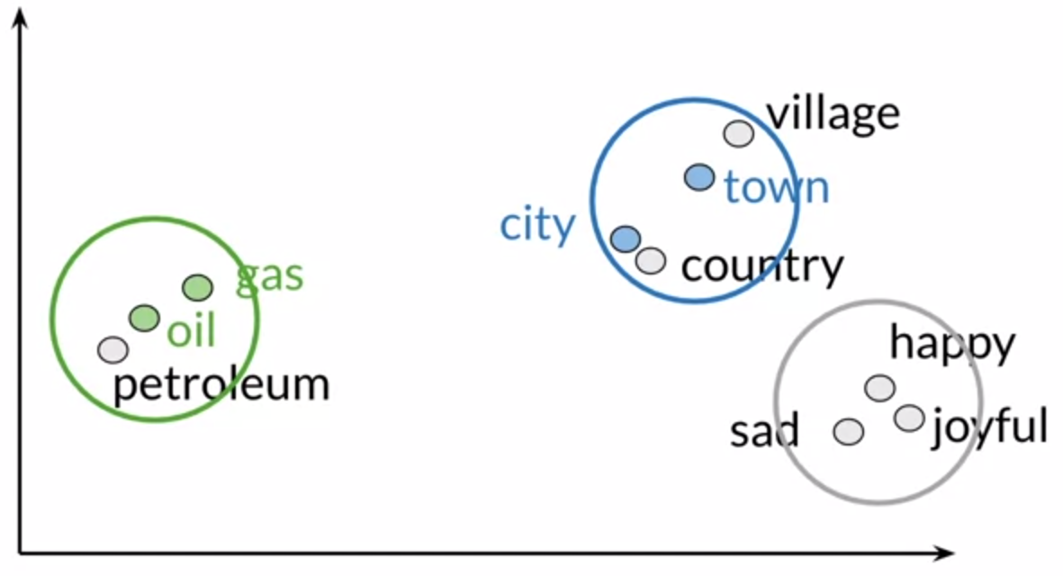
1) Visualization of word vector

Slide 34
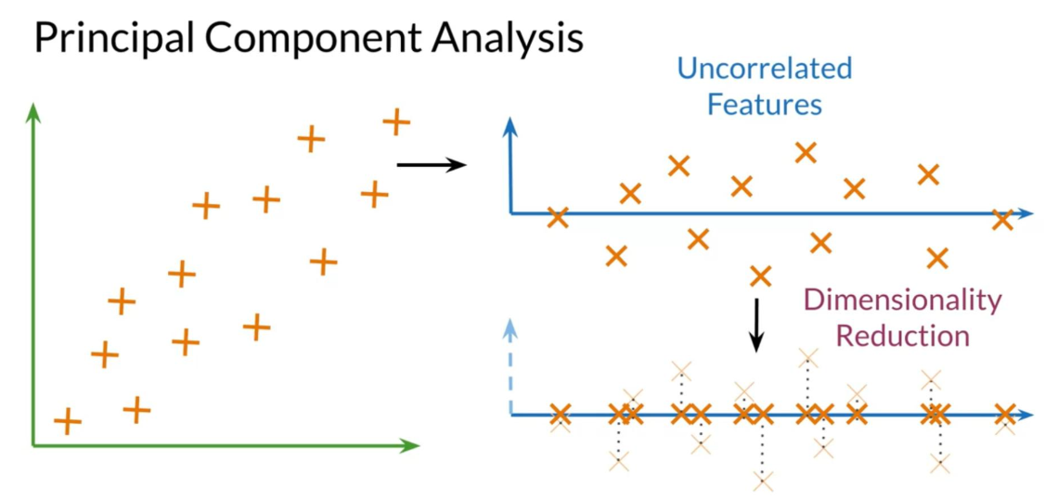
2) Principal Component Analysis

Slide 35
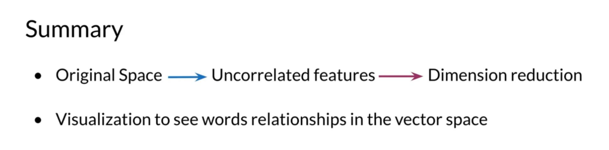
Summary
Original Space Uncorrelated features Dimension reduction
Visualization to see words relationships in the vector space

Slide 36
(8) PCA Algorithm
Outline
How to get uncorrelated features
How to reduce dimension while retaining as much information as possible

Slide 37
Principal Component Analysis

Slide 38
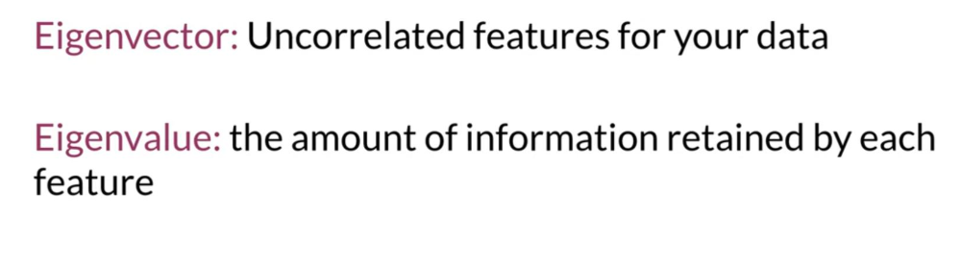
PCA algorithm

Slide 39
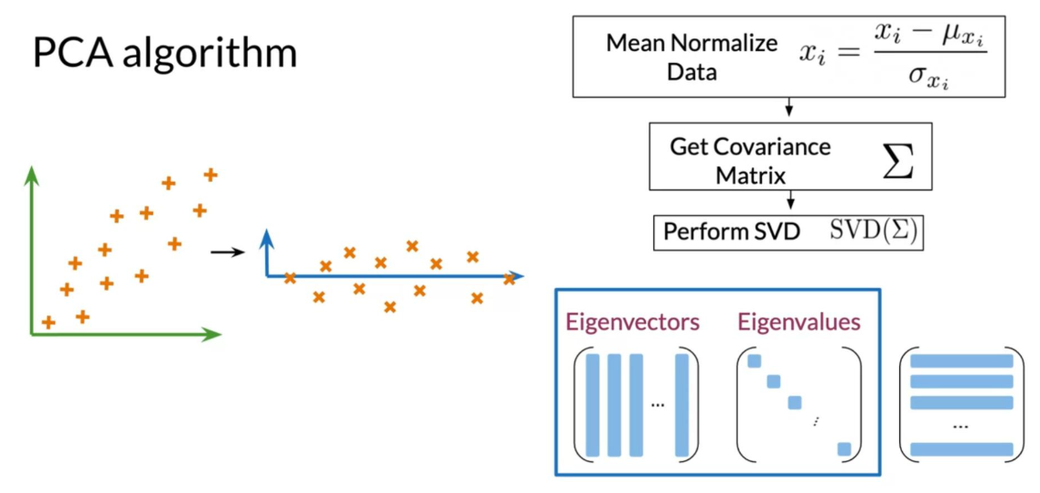
PCA algorithm

Slide 40
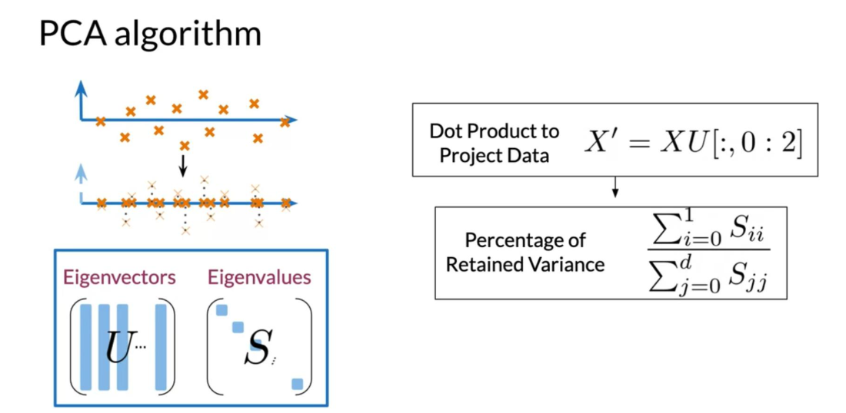
PCA algorithm

Slide 41
Summary
Eigenvectors give the direction of uncorrelated features
Eigenvalues are the variance of the new features
Dot product gives the projection on uncorrelated features

